Slide 1
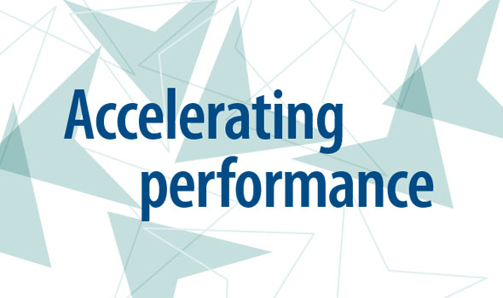
by enhancement of Job Clarity, Culture & Competency
By,
Ramya BL
RMines Services Pvt Ltd

Slide 2
About us
RMines Services Pvt Ltd is professional HR women driven services based company. Our business expertise’s are:
Talent Management & Learning Solutions
Campus Placement & Corporate Training
Recruitment Solutions
HR Consulting & Outsourcing
Payroll Management Solutions
Professional Staffing Solutions
Regulatory Compliance Services
We at RMines give HR solutions, Performance Solutions, Learning Solutions and Payroll Services and work together as a team, and there is no individual more significant for us than our customers. We modify our services to fulfil our customer’s requirements. Also, our services are scalable; so it doesn’t matter if you are a small or large company, our services will be your solution.

Slide 3
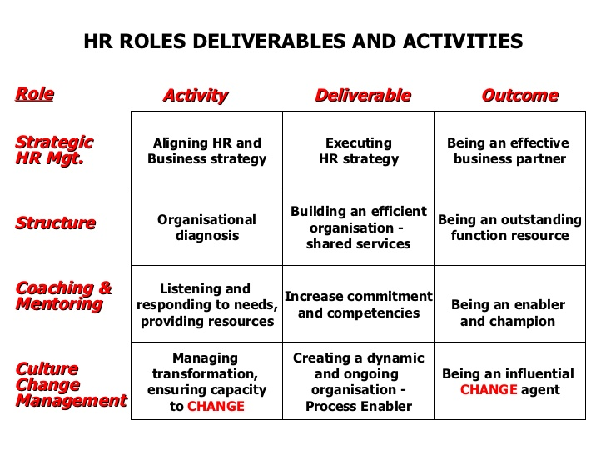
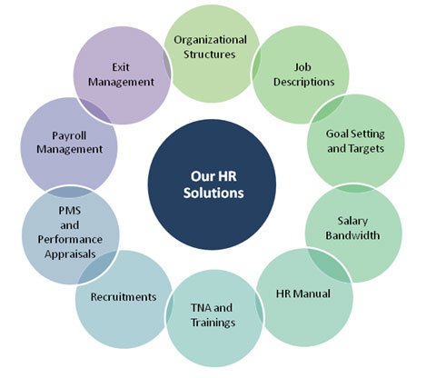
Services included in HR outsourcing:

Slide 4
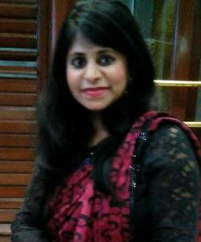
HR CONSULTANT & LEADERSHIP COACH Contact: 9945259466 | Email: ramya@rmines.com | Location: Bangalore
Dynamic HR Consultant, Leadership Coach & Trainer with experience in delivering customized learning solutions and effectiveness measurement.
A Dynamic Human Resources Professional with 12 years of experience. My passion is providing HR solutions for the clients by helping them build their HR infrastructure through technology, compliance and people. Prior to launching RMines, I held several corporate HR leadership positions in manufacturing, IT, Telecom and professional services organizations.
Also have helped many corporates by implementing the Performance systems by enhancing The Job Clarity, The Culture & The Competencies.
BBM graduate with MBA in HR from Pune University. Also I am certified Six Sigma Green Belt.
LEADERSHIP SERIES Executive Coaching: Overcome barriers/dilemmas for success Championship Team Building: Essentials for leadership Psychometric Assessment: Understand Personality traits | SALES TRAINING Advance Selling Skills Negotiations Skills Client Servicing Presentation Skills Retail Sales Technique | BEHAVIORAL TRAINING Emotional Intelligence Conflict Management Effective Communication Grooming & Appearance Interpersonal Skills Time Management
Passion for People Development

Slide 5
Objective of PACE System
To build the High Performance Team
Align the objectives of the individual with those of the business through Job Clarity, Competencies & Culture
Enhance the capacity and competence of individuals so that they exceed organizational expectation and work in a way that effectively and efficiently attains business strategic objectives.
Improve Organizational Performance
Develop Performance Culture
Where people are focused on objectives, improvement & Development
Performance is properly measured and feedback is timely & adequate

Slide 6
Define Business Aspiration Goals
Financial Centric
Performance Planning
Define Structure, Role Clarity & Role Competency & Attributes
Design Departmental and Individual Score card (Define KRA & KPI)
Competence Development
Customer Centric
Team Centric
Functional Centric
Learning Centric
Create Development Plan
Individual & Team Goal Setting
Action Plans & Evaluation
Implementation of STOP System
Training Need Analysis
Assess
Problem/Organization Needs Assessment
Review Current People Competency, System, & tools
Personal Development Action Plan
Learning System
Design Compensation and Benefit Structure
Design feedback system
Design & Conduct Performance Review & Appraisal
Strategic meeting
Tactical meeting
Operation meeting
Action Discipline
Training Needs Assessment
Competency Gap Tracking
Competency Implementation
Sign off
Develop Rewards & Recognition
Communicate Expectations
Performance Management System

Slide 7
Outcome of Performance Management
Clarifying job responsibilities & expectations.
Enhancing individual & group productivity
Developing employee capabilities to their fullest extent through effective feedback & coaching
Driving behavior to align with the organization’s core values, Goals & Strategy.
Improve communication between employees & managers

Slide 8
HR Consultant Deliverables
Role Definition | Assists the organisation in converting their business goals to department and section goals and then to individual employee goals. RMines offers PMS consulting services to organisations, helping them make employee performance review a transparent process. A good review and reward system will boost the organisation’s growth trajectory towards its goals through a satisfied workforce.
Responsibility Deliverable | Responsible for aligning business objectives with employees and management in designated business units. The position serves as a consultant to management on human resource-related issues. Acts as an employee champion and change agent. The role assesses and anticipates HR-related needs. The position formulates partnerships across the HR function to deliver value-added service to management and employees that reflects the business objectives of the organization. Ensures HR objectives are met i.e., hiring right people, people development & people satisfaction. Ensure MIS reports are maintained & dashboards are presented to Management.
Tasks & Activities | Conducts weekly meetings with respective business units. Consults with line management, providing HR guidance when appropriate. Analyses trends and metrics in partnership with the HR group to develop solutions, programs and policies. Manages and resolves complex employee relations issues. Conducts effective, thorough and objective investigations. Provides day-to-day performance management guidance to line management (e.g., coaching, counselling, career development, disciplinary actions). Works closely with management and employees to improve work relationships, build morale, and increase productivity and retention. Provides guidance and input on business unit restructures, workforce planning and succession planning. Identifies training needs for business units and individual executive coaching needs. Participates in evaluation and monitoring of training programs to ensure success. Follows up to ensure training objectives are met.

